Slide 1

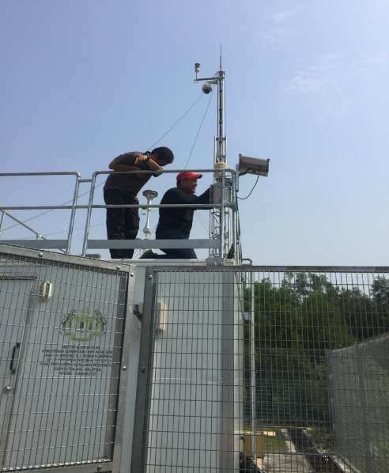
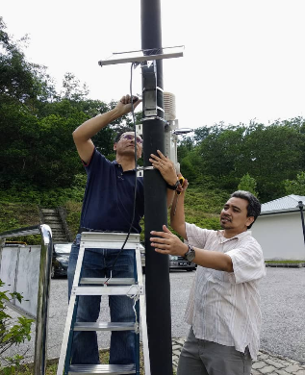
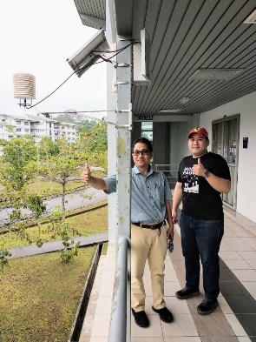
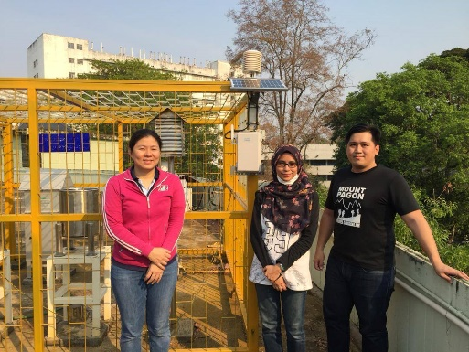
Air Quality From Biomass Burning
Putrajaya
Fraser Hill
Kuching
Chiang Mai

Slide 2
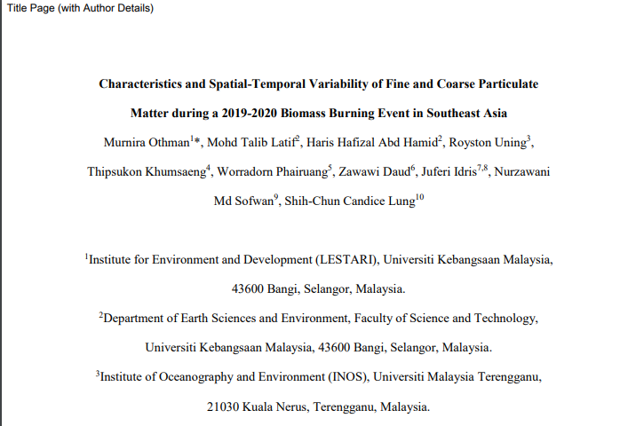

Slide 3
Thailand
Malaysia

Slide 4
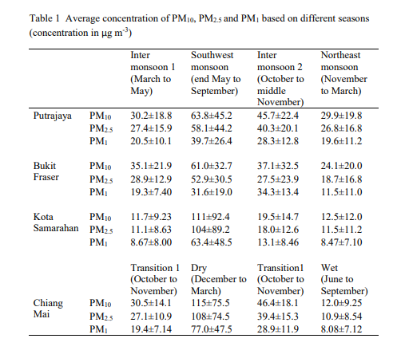
Main Data

Slide 5
Research Paper

Slide 6
Current/Next Paper Preparation
Air quality during different monsoon seasons in SEA –Thailand, Malaysia and Indonesia (Fabien, Puji)
- Different type of biomass burning
- Correlation/Comparison with other main criteria air pollutants
- Meteorological/seasonal factors/hotspots
Comparison between sensors AS-Lung, AirboxSense, CAQM Data from Malaysian DOE

